Slide 1





MAMC01803 Analytics for Managers
Week 4 (Session 1): Diagnostic Analytics

Slide 2

In this lecture:
Topic 1: Finding a dataset
Topic 2: Exercises of diagnostic analytics
Assessment Two

Slide 3
Individual task and group discussion: Finding your dataset for Assessment Two
Try to find a dataset relating to your business problems from Kaggle/other sources provided on Moodle (see ‘Assessments’). These can be related to your business problems from assessment 1.
You will use the data from the selected dataset to conduct at least three types of analytics we cover in this course for your Assessment Two;
Criteria of dataset for Assessment Two: at least 1000 rows AND at least 20 columns. Mix of categorical and numerical data.

Slide 4
Individual task and group discussion: Finding your dataset for Assessment Two
Please discuss your dataset with your group members
Preparation: Identify at least one business problem from your dataset (three would be better ☺) before our second class (Week 4).

Slide 5
Diagnostic analytics
Diagnostic analytics is the process of using data to determine the causes of trends and correlations between variables. It can be viewed as a logical next step after using descriptive analytics to identify trends. Diagnostic analysis can be done manually, using an algorithm, or with statistical software (such as Microsoft Excel).
There are several concepts to understand before diving into diagnostic analytics: hypothesis testing, the difference between correlation and causation, and diagnostic regression analysis.
Reading: https://online.hbs.edu/blog/post/diagnostic-analytics

Slide 6
T-Test
T- Test: statistical procedure that analyses whether there is a significant difference between the MEANS (averages) of two groups. (e.g. Revenue of item A vs Revenue of Item B).
One sample t test: used to compare mean value of a group with a known mean value.
Paired sample t test: used to compare mean values of the same group.
Independent sample t test: used to compare the mean values of one group with the mean values of another group. Can be done only with 2 groups.

Slide 7
T-Test
Hypothesis testing: the statistical process of determining if there is enough evidence in a data to support or reject a specific assumption. Having a hypothesis to test can guide and focus your diagnostic analysis.
Hypothesis testing for an independent sample t test: null hypothesis: the mean values in both groups are the same. alternative hypothesis: the mean values in both groups are not equal.
P-value (two tail): If the p-value is less than or equal to your alpha level (0.05), your results indicate a statistically significant difference between the two groups.

Slide 8
ANOVA
A one-way ANOVA (Analysis of Variance) is a statistical test used to compare the means of three or more groups to see if at least one group mean is significantly different from the others.
One-way means that you’re comparing groups based on one factor (like different types of teaching methods or different brands of a product).
Hypothesis testing for one-way ANOVA: null hypothesis: the mean values in all groups are the same. alternative hypothesis: the mean values in at least one group is different from others.
P-value: If the p-value is less than or equal to your alpha level (0.05), your results indicate a statistically significant difference between the groups.
F is greater than F critical: results indicate a statistically significant difference between the groups.

Slide 9
Exercise: Diagnostic analytics
Please complete the following tasks:
Read the materials about t-test/ANOVA (see our Teams group)
Work on the following datasets:
Male and Female scores – t-test
Festival expenditure - ANOVA
Upload your answers with interpretation on teams (class activities-> week 4 session 1)

Slide 10
Assessment Two
Instructions:
Find a dataset (at least 1000 rows and 20 columns) that has a good mix of numerical and categorical variables. This can be related to your problems from assignment 1.
Categorize the variables from the dataset as categorical or numerical and provide a description for each.
Frame 3 business problems from the dataset.
Perform at least 3 analysis techniques (descriptive, diagnostic, predictive, prescriptive) on your dataset to address your 3 business problems.
Write a detailed analysis report.

Slide 11
Assessment Two
For the analysis report:
Explain your dataset.
Discuss the 3 business problems in detail (define the problems and address the significance of the problems).
Critically discuss the potential data analysis techniques, mention which techniques you would use to address which problem, and justify why you decided to use these techniques to address your identified problems.
After you have applied the selected techniques (at least 3) to generate analysis results for your 3 problems -> critically interpret and justify the analysis results to provide and support recommendations that would help address the 3 problems.

Slide 12
Assessment Two
You will use journal articles for the following purposes in Assignment 2:
Discuss the significance of the data problems
Support the identification of the variables
Support the justification of the data analysis methods
Expand/support the recommendations you provide from your analysis.

Slide 13
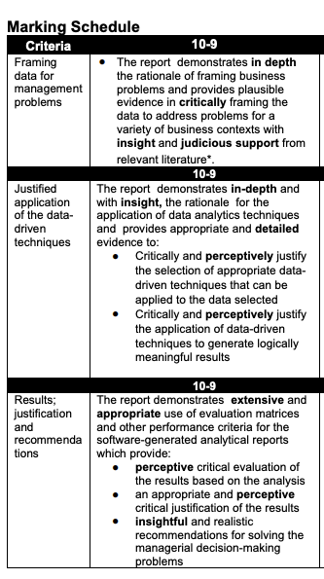
Assessment Two
Word count guidance: 3000 words
Due date: Monday Week 9 (7 April 2025), 9:00 AM

Slide 14
Homework
Categorize your variables from the dataset as categorical or numerical.
Identify 3 business problems from your dataset that you would like to address.
Perform descriptive analysis (descriptive statistics using data analysis toolpak, pivot tables etc) on your dataset to address your problem(s).
Interpret the analysis results.
Try to perform diagnostic analysis (t-test and ANOVA) on your dataset to address your problem(s).

